Slide 1
CC - GIT Migration Approach
1
Internal | Sabareesh SS (ECA36) | 23/08/2016 | © Robert Bosch Engineering and Business Solutions Limited 2011. All rights reserved, also regarding any disposal, exploitation, reproduction, editing, distribution, as well as in the event of applications for industrial property rights.

Slide 2
For Migration with history and latest data
Clearcase cannot be mapped 1:1 to Git
2
Internal | Sabareesh SS (ECA36) | 23/08/2016 | © Robert Bosch Engineering and Business Solutions Limited 2011. All rights reserved, also regarding any disposal, exploitation, reproduction, editing, distribution, as well as in the event of applications for industrial property rights.

Slide 3
Migration Option
Latest Data and Incremental Data Migration
Migrate from Base Clearcase to Subversion using Polarian SVN Importer tool
Migrate from Subversion to Git using svn2git gem file
Clearcase
Subversion
Git
Internal | Sabareesh SS (ECA36) | 23/08/2016 | © Robert Bosch Engineering and Business Solutions Limited 2011. All rights reserved, also regarding any disposal, exploitation, reproduction, editing, distribution, as well as in the event of applications for industrial property rights.
Notes:
3

Slide 4
Prerequisites
Version Control Setup
Base Clearcase
Subversion with Server
Git
Tools / Environmental Setup
Java JRE
svn-importer
Ruby(svn2git)
Internal | Sabareesh SS (ECA36) | 23/08/2016 | © Robert Bosch Engineering and Business Solutions Limited 2011. All rights reserved, also regarding any disposal, exploitation, reproduction, editing, distribution, as well as in the event of applications for industrial property rights.
Notes:
4

Slide 5
Migration - BCC to SVN
Create dynamic view for BCC VOB
Open and edit config.properties file of Polarian SVN-Importer tool with respect to Clearcase.
Run the svnimporter.jar file with the below command:
run.bat full config.properties
Full dump file (partition dump files) will get created.
Load the dump to subversion with the below command:
svnadmin load [Repository Path] < [Dump file]
Validate Subversion Repository path.ffgfgfg
Internal | Sabareesh SS (ECA36) | 23/08/2016 | © Robert Bosch Engineering and Business Solutions Limited 2011. All rights reserved, also regarding any disposal, exploitation, reproduction, editing, distribution, as well as in the event of applications for industrial property rights.
Notes:
5

Slide 6
Migration - SVN to GIT
Each clone in Git is a Replica.
Get the subversion url.
Run svn2git with the below command:
svn2git [subversion-url]
Validate the Git Repository.
Internal | Sabareesh SS (ECA36) | 23/08/2016 | © Robert Bosch Engineering and Business Solutions Limited 2011. All rights reserved, also regarding any disposal, exploitation, reproduction, editing, distribution, as well as in the event of applications for industrial property rights.
Notes:
6

Slide 7
GIT, A different Clearcase
Create and go to a folder for Git repository initialization.
There are No Check-in and Check-out commands in Git.
There are No Views and Configuration specifications in Git.
There is No file based access control in Git.
Internal | Sabareesh SS (ECA36) | 23/08/2016 | © Robert Bosch Engineering and Business Solutions Limited 2011. All rights reserved, also regarding any disposal, exploitation, reproduction, editing, distribution, as well as in the event of applications for industrial property rights.
Notes:
7

Slide 8
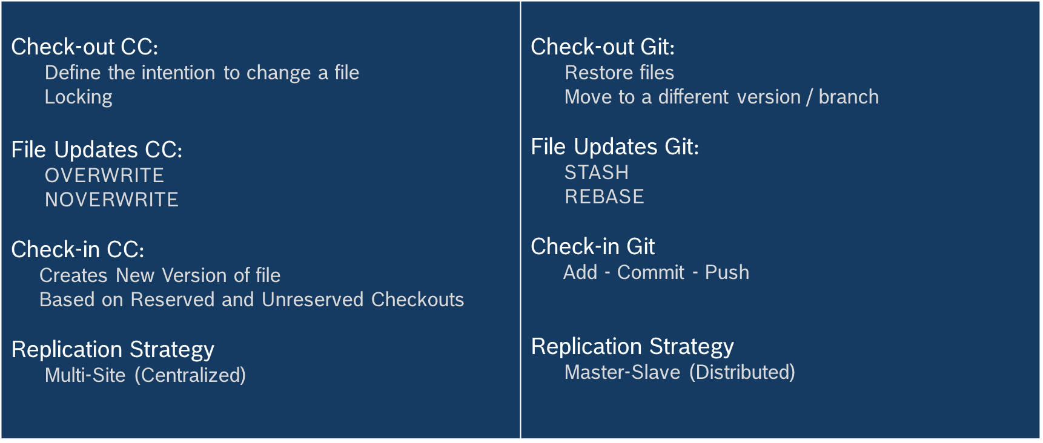
Clearcase Vs GIT
Internal | Sabareesh SS (ECA36) | 23/08/2016 | © Robert Bosch Engineering and Business Solutions Limited 2011. All rights reserved, also regarding any disposal, exploitation, reproduction, editing, distribution, as well as in the event of applications for industrial property rights.
Notes:
8

Slide 9
The bottom-line in migration from Clearcase to Git is that it involves some refactoring and reorganization of the source code in order to have the manageable Git repositories.
Internal | Sabareesh SS (ECA36) | 23/08/2016 | © Robert Bosch Engineering and Business Solutions Limited 2011. All rights reserved, also regarding any disposal, exploitation, reproduction, editing, distribution, as well as in the event of applications for industrial property rights.
Notes:
9

